Slide 1


BITCOIN PRICE PREDICTION
LOGO
Group Name: DataEureka
Notes:
intro：
Is it possible to predict tomorrow’s Bitcoin price?
In this video，we are presenting to you our exercise exploring the potential use of the LSTM model for the purpose of daily Bitcoin price prediction.

Slide 2


Agenda
Bitcoin Price Prediction
Data collection
Data cleaning and preprocessing
Basic LSTM Model baseline
Features Engineering
Modeling and optimization
03
DataEureka
Notes:
Through this video, i will lead you through our process of
Data collection
Data cleaning and preprocessing
Basic LSTM Model baseline
Features Engineering
Modeling and optimization

Slide 3
1 Bitcoin property and network
Bitcoin Daily Average Prices, Hash Rate, Miner Rewards, Miner Reserves,…
Data Input
2 Bitcoin Marketing and trading
Number of Large Transactions, Average Transaction Size, Average Balance, Average Time Between Transactions, …
Collected from：
Downloading open-source database
Web crawler
Collated to be： structured
sequenced in time series.
Dated Between：
2020/9/16 ~ 2021/9/17
3 Global economic indicators
Gold price, US dollar index,
Dow Jones Commodity index, …
4 Investors and Media Attention
Google trend, Twitter positive, Twitter negative, …
5 Prices of Other Cryptocurrencies and BTC Index
Ethereum, Dogecoin, CCI30*
DataEureka
Notes:
We grabed data by two methods, download from open-source database and web crawler.
we collated data to be structured and sequenced in time series.
For convenience, only (past 1 year)2020/9/16 ~ 2021/9/17 data collected.
Data source can be divided in the following 5 aspects:
bitcoin property and network related variables, including prices, hash rate, miner rewards, miner reserves …
miner reverse: Balances of addresses belonging to mining pools, shown for specific large pools, in aggregate, unknown miners or other small mining pools.
2. Bitcoin Marketing and trading:
Number of Large Transactions, Average Transaction Size, Average Balance, Average Time Between Transactions, …
3. Global economic indicators：
Gold price, US dollar index,
Dow Jones Commodity index, …
4. Investors and Media Attention： google trend， twitter sentiments referred to Bitcoin (negative, positive, ..)
5. Prices of Other Cryptocurrencies and BTC Index: Ethereum, Dogecoin, CCI30*

Slide 4
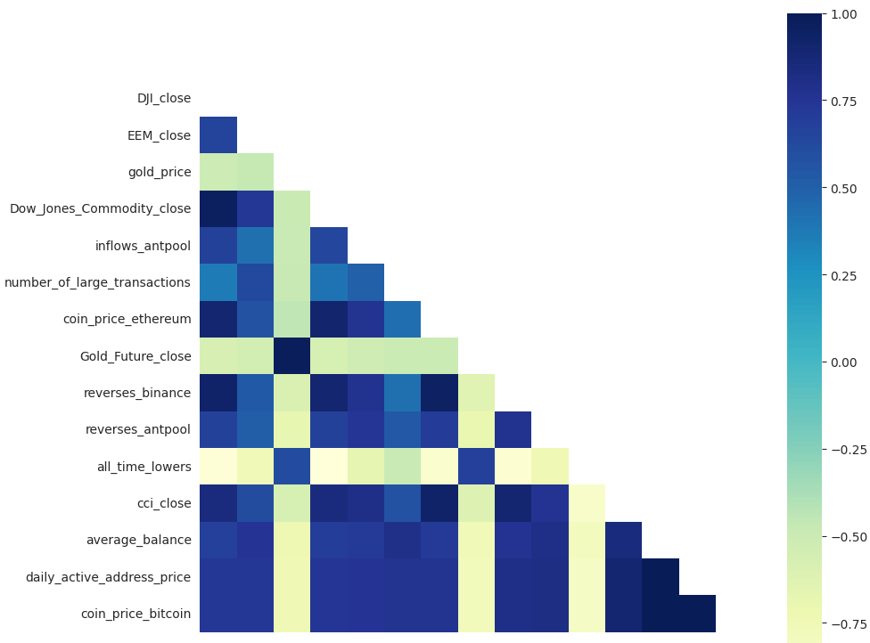

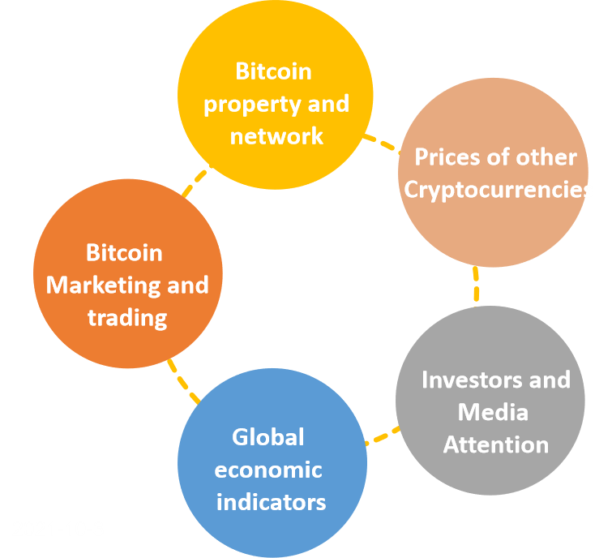
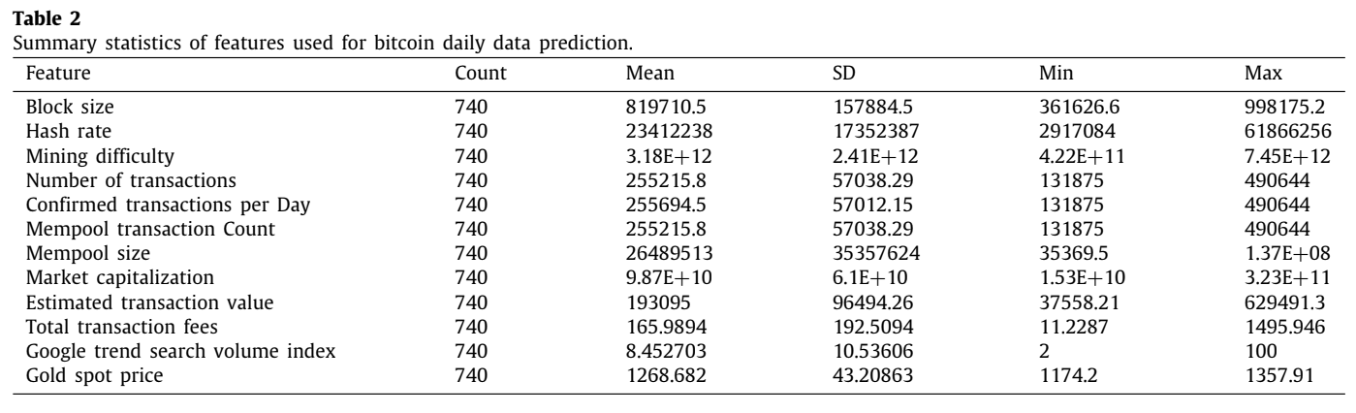
Data Preprocessing
Description Analysis
Correlation Matrix
Basic Statistics
DataEureka
Notes:
In data-preprocessing, for all the collected data, we have first done descriptive analysis to go through the basics of data status. Here is a demostration form of the statistics.
A correlation matrix is also plotted for visualizing significance for the different features.

Slide 5
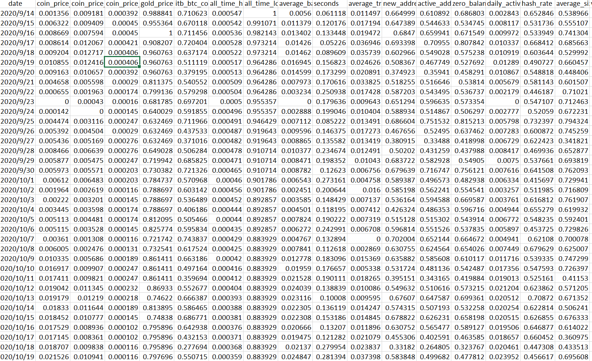
content requires update
Data Preprocessing
Data Cleaning
Data Normalization
Data outcome
Imputation:
Google trend, Titter trend
Too many missing values - dropped
US index, Gold price, etc,
Impute by Friday numbers
Redundancy:
Miners related features
Drop similar miner pools
BTC price similarity
High correlation but no contribution - dropped
Min-Max Scaler to
normalize the data.
1 Date + 61 features
365 days
DataEureka
Notes:
Then we did data cleaning,
for missing values, if the missing amount is large, like Google trend, Titter trend, we decides to drop them
for the others, we did imputation with reference from the context like US index we impute from friday value
For data normalization，we used minmax scaler.
Here is the final data outcome: we have 55 features remained aligned with 365 days time series

Slide 6
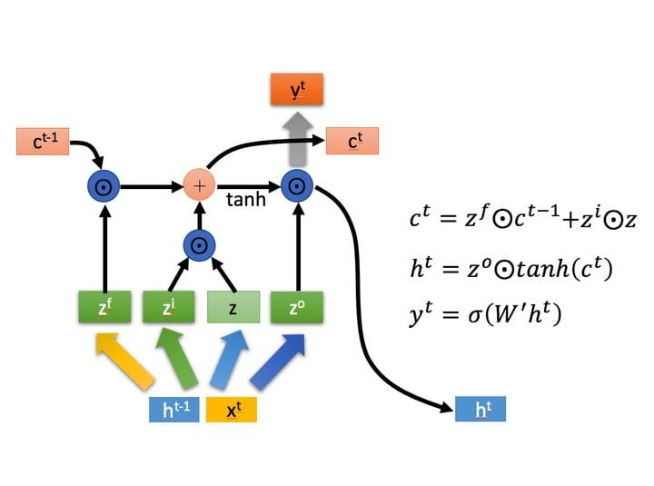
Long short-term memory(LSTM)
Purpose
capable of learning long-term dependencies
use prior experience to inform future outcomes
DataEureka
Notes:
After data processing, we started our experiments with LSTM model, which is mostly used for time series data prediction.
So what is the LSTM model exactly? In short, it’s a form of recurrent neural network capable of learning long-term dependencies. In a similar fashion that we use prior experience to inform future outcomes, LSTM models use update gates and forget gates to randomly remember and forget pieces of historical information to inform their prediction.
started with a basic LSTM model in mind, we had our first attempt.

Slide 7
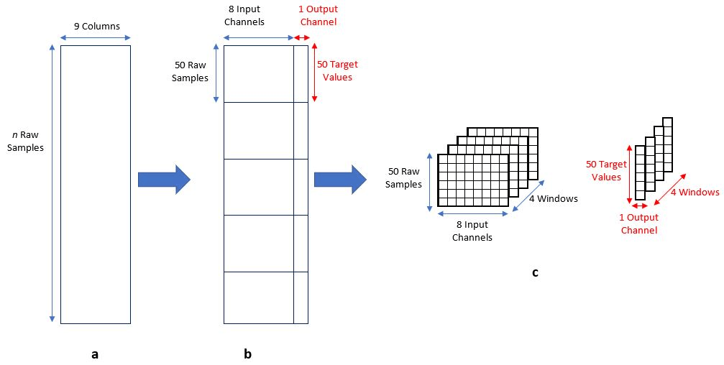
content requires update
Data Split
Extract data windows
Train Test Split
split ratio
= 0.2
DataEureka
Notes:
Before modelling, we need to split the data into train set and test set.Here, we set the split ratio as 0.2 which means leave 20% data as test set.
Then, to fit in the model, we create a time window of consecutive days’of features.
After experiments, we found that the time window of 10 would be a reasonable choice.
Moreover, we follow the time series and move this window one day to the right. Therefore, we have 355 subsets which every set contains 10 consecutive days’ features. In short, our input are X which has consecutive features and Y which has the price of Bitcoin in these days.

Slide 8
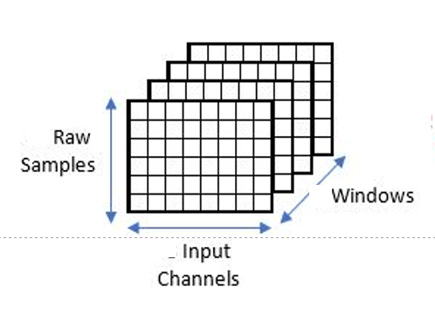
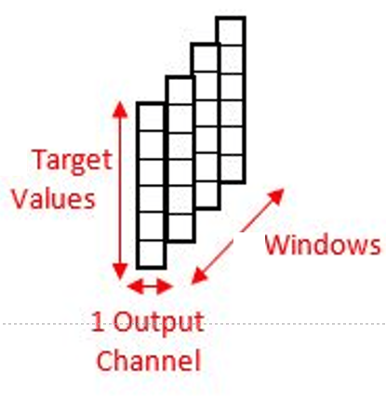
Data Preprocessing
Extract data windows
Train Test Split
We used a ratio of 0.2 to split train and test sets. So the data of last 60+ days was used for testing.
Original data shape
X: (366 * 61) Y: (366 * 1)
After concatenating
X: (366 * 10 * 61) Y: (366 * 1)
After splitting
X_train: (300 * 10 * 61) X_test: (66 * 10 * 61) Y:_train: (300 * 1) Y_test: (66 * 1)
X_train, X_test
Y_train, Y_test
We decided to combine data of a certain time window as input to predict bitcoin price of next day.
After experiments, we found that the time window of 10 would be a reasonable choice.
DataEureka
Notes:
Before modelling, we need to split the data into train set and test set.Here, we set the split ratio as 0.2 which means leave 20% data as test set.
Then, to fit in the model, we create a time window of consecutive days’of features.
After experiments, we found that the time window of 10 would be a reasonable choice.
Moreover, we follow the time series and move this window one day to the right. Therefore, we have 355 subsets which every set contains 10 consecutive days’ features. In short, our input are X which has consecutive features and Y which has the price of Bitcoin in these days.

Slide 9
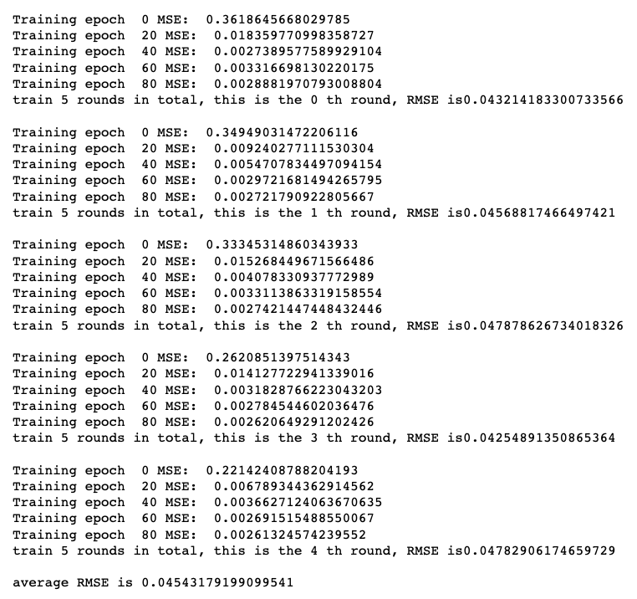
Model Evaluation
train and test the model 5 rounds
calculate their average RMSE as a indicator of its performance
fixed the random seed in each round to ensure it can be reproduced
DataEureka
Notes:
There are high and uncertainty in neural network training. In order to ease this problem, for each experiment, we train and test the model 5 rounds and calculated their average RMSE as a indicator of its performance. Meanwhile, we fixed the random seed in each round to ensure the experiments can be reproduced.

Slide 10
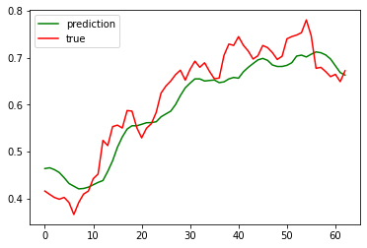
Baseline Model
First Attempt
All features are used for modeling
AvgMSE=0.0454
DataEureka
Notes:
For the first step, we set the parameters by default and train the model by putting in all the features which means we do not do any feature selection because the original MSE will be useful for us to compare with the final MSE, setting up a model baseline.
For this prediction model, the Y axis is the price after normalization and x axis is the days that we used in the test set.
The split ratio is 0.2, so we just have 60 days in our test sets.

Slide 11
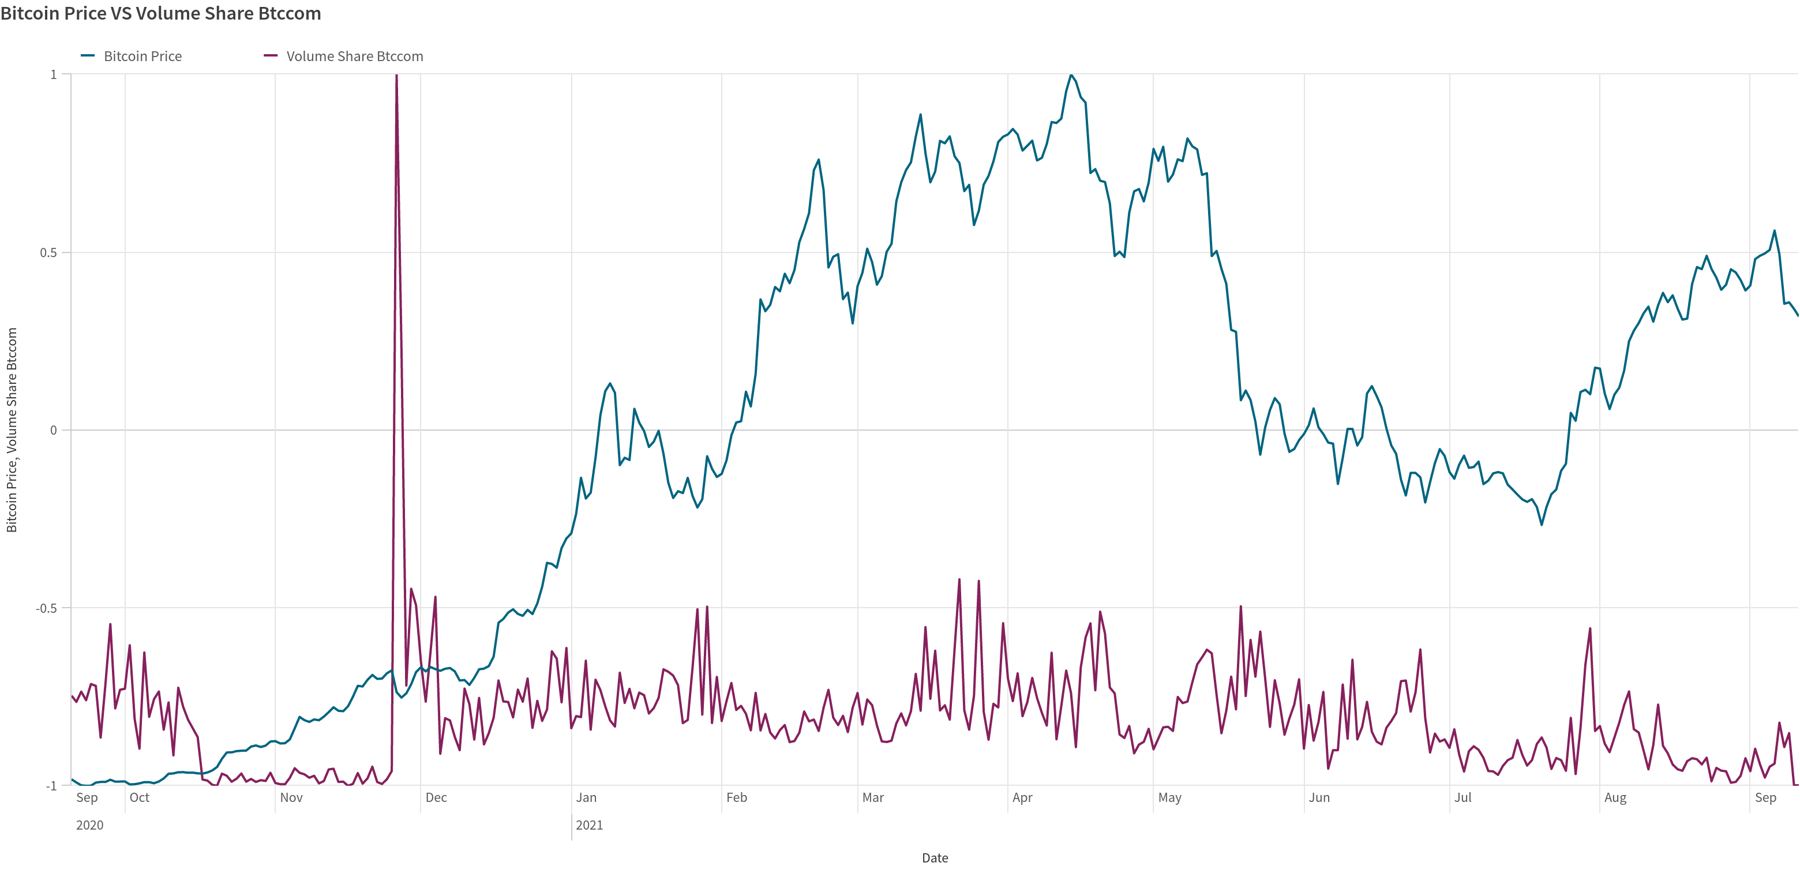
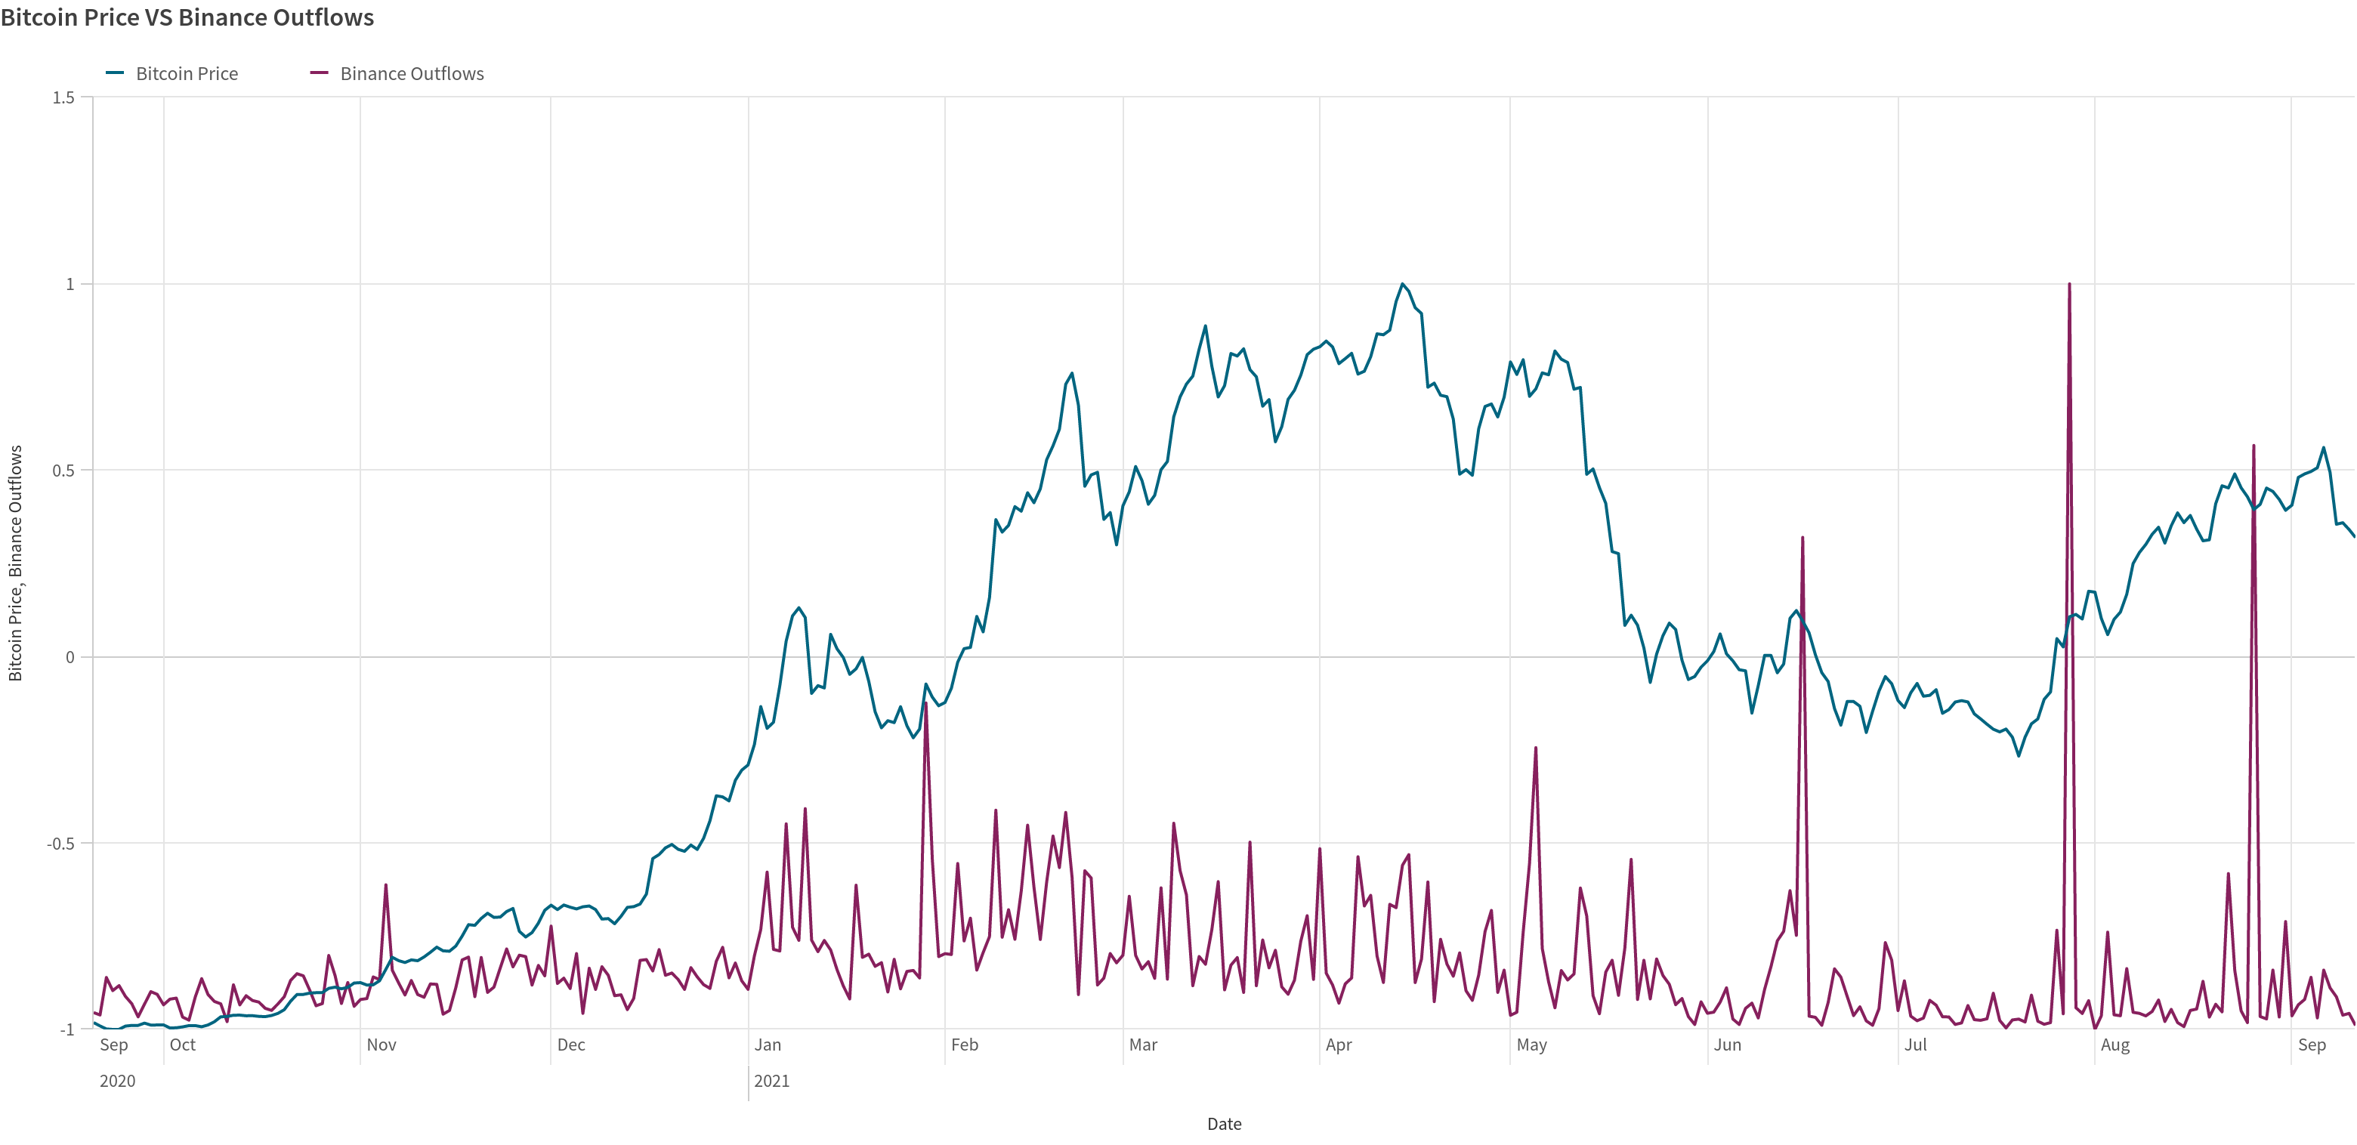
content requires update
Features Engineering
Need criteria to drop columns with low significance!
1. Noise
BTC Price V.S. Volume share Btccom
BTC Price V.S. Binance outflows
DataEureka
Notes:
However, using all features run model,the result is not that satisfactory.
Furtherly explore the features, we discovered some problems, hence requires further feature engineering
There are noises in the dataset, showing low relation to the price changes.
Hence we need criteria to drop columns with low significance.

Slide 12
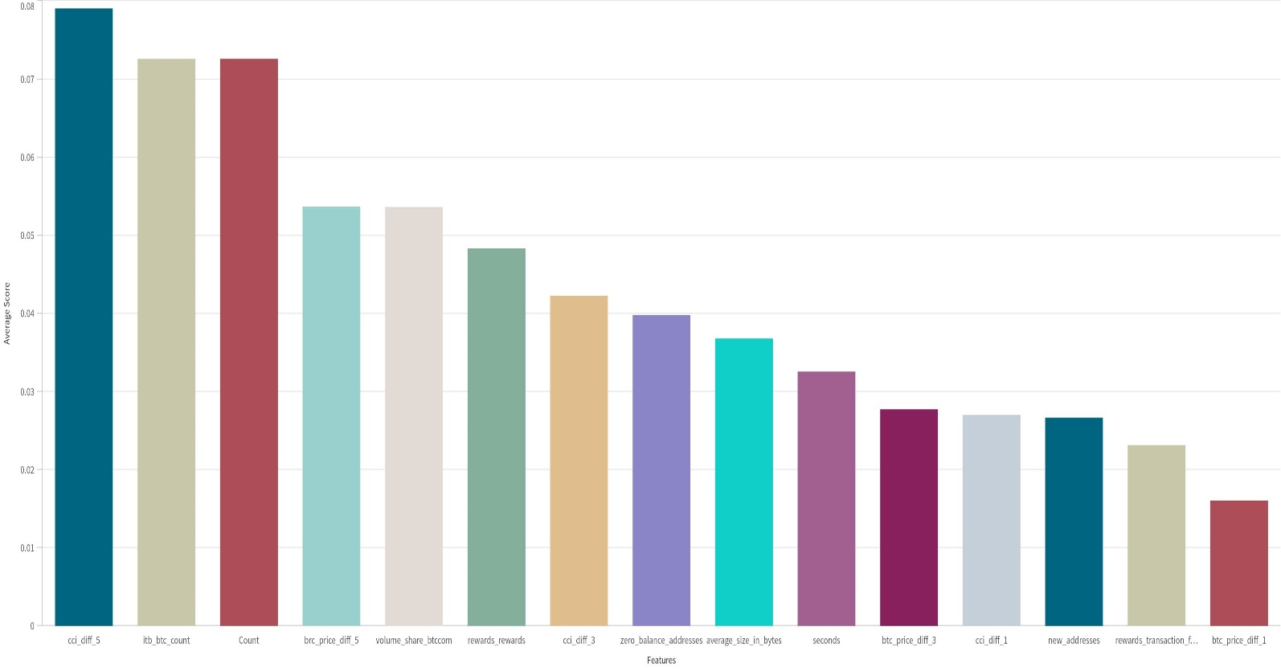
content requires update
Features Engineering
1 Correlation with target
Features scoring
Calculate the average of three methods results after scaling.
2 Regularization
2-1 Ridge, alpha=5
2-2 Random forest regressor
Tuning coefficients of data that suffers from multicollinearity
…
Drop features with average score below 0.09
DataEureka
Notes:
to choose the features, we used three scores and took the average. They are correlation coeeficient、and ridge coefficients，random forest regressor for regularization purposes.
we choose features with average above 0.09

Slide 13



Features Engineering
2. Add Lagging Effect Features
$${Return}_{1−day}=\frac{{Price}_{t}−{Price}_{t−1}}{{Price}_{t−1}}$$
1-day lag Bitcoin Price return rate:
$${Return}_{1−day}=\frac{{Price}_{t}−{Price}_{t−3}}{{Price}_{t−3}}$$
3-day lag Bitcoin Price return rate:
$${Return}_{1−day}=\frac{{Price}_{t}−{Price}_{t−5}}{{Price}_{t−5}}$$
5-day lag Bitcoin Price return rate:
DataEureka
Notes:
2. we also added lagging variables
To find out whether bitcoin price has lagging effect, we added the 1-day, 3-day, 5-day return rate data into our features

Slide 14



Features Engineering
3. Add Lagging Effect Features
lagging Crypto Currency Index (CCI)
$${\hat{CCI}}_{1−day}=\frac{{CCI}_{t}−{CCI}_{t−1}}{{CCI}_{t−1}}$$
1-day lag CCI increase rate:
$${\hat{CCI}}_{3−day}=\frac{{CCI}_{t}−{CCI}_{t−3}}{{CCI}_{t−3}}$$
3-day lag CCI increase rate:
$${\hat{CCI}}_{5−day}=\frac{{CCI}_{t}−{CCI}_{t−5}}{{CCI}_{t−5}}$$
5-day lag CCI increase rate:
DataEureka
https://cci30.com/
Notes:
Besides, we also want to find out whether the lagging Crypto Currency Index (CCI) can be good features in our model
here we used cci30
The CCi30 is a rules-based index designed to objectively measure the overall growth, daily and long-term movement of the blockchain sector. It does so by tracking the 30 largest cryptocurrencies by market capitalization

Slide 15
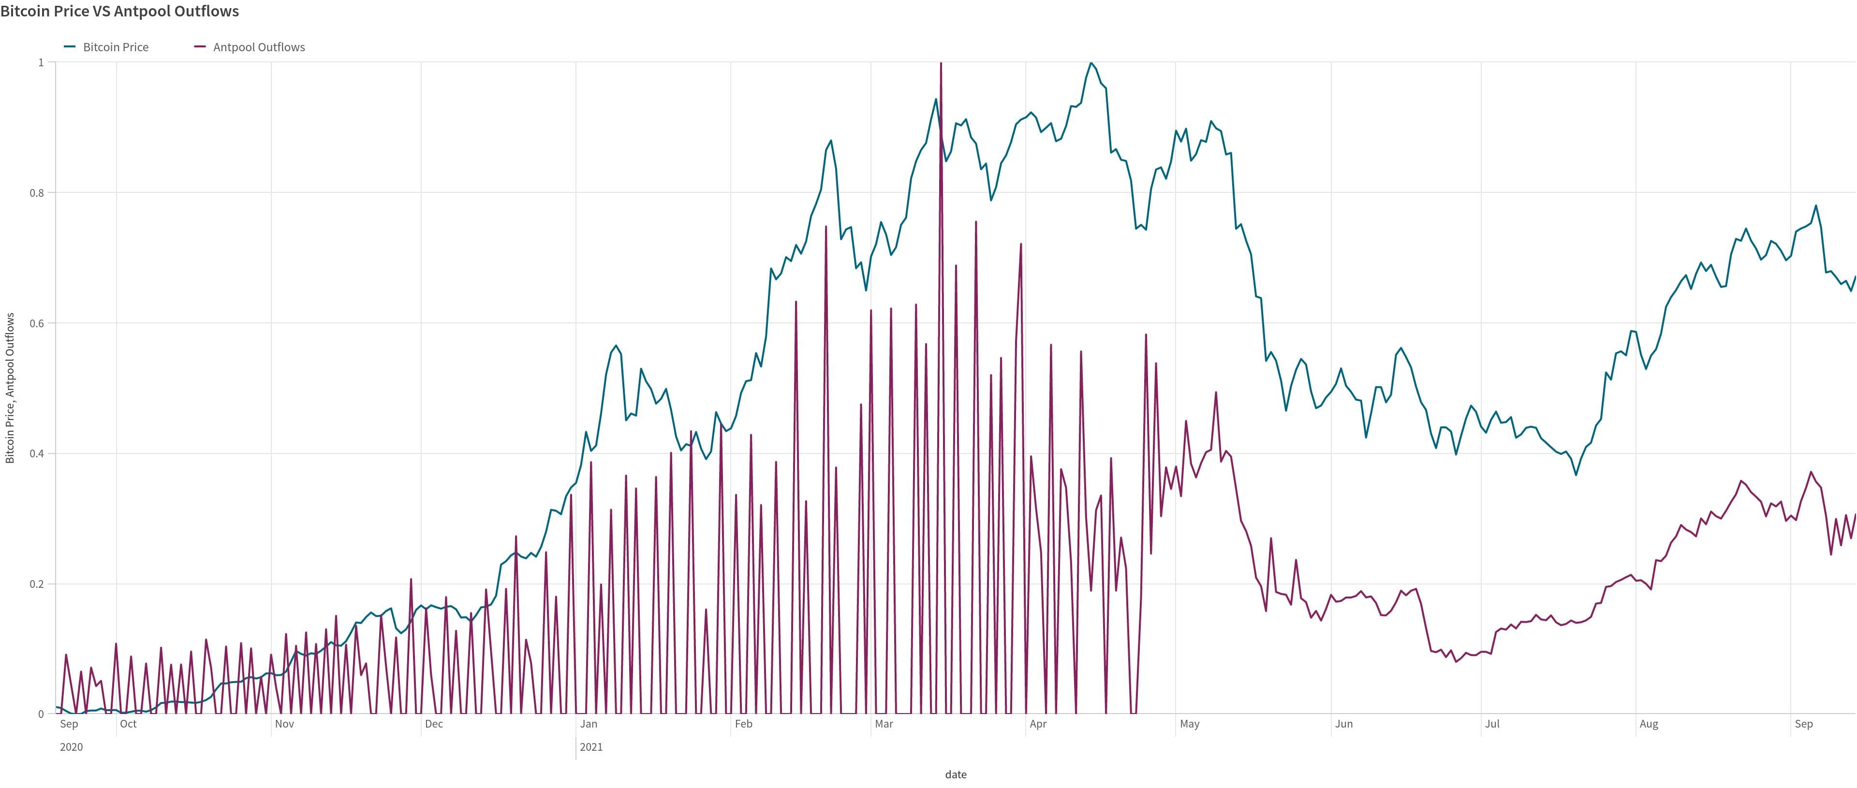
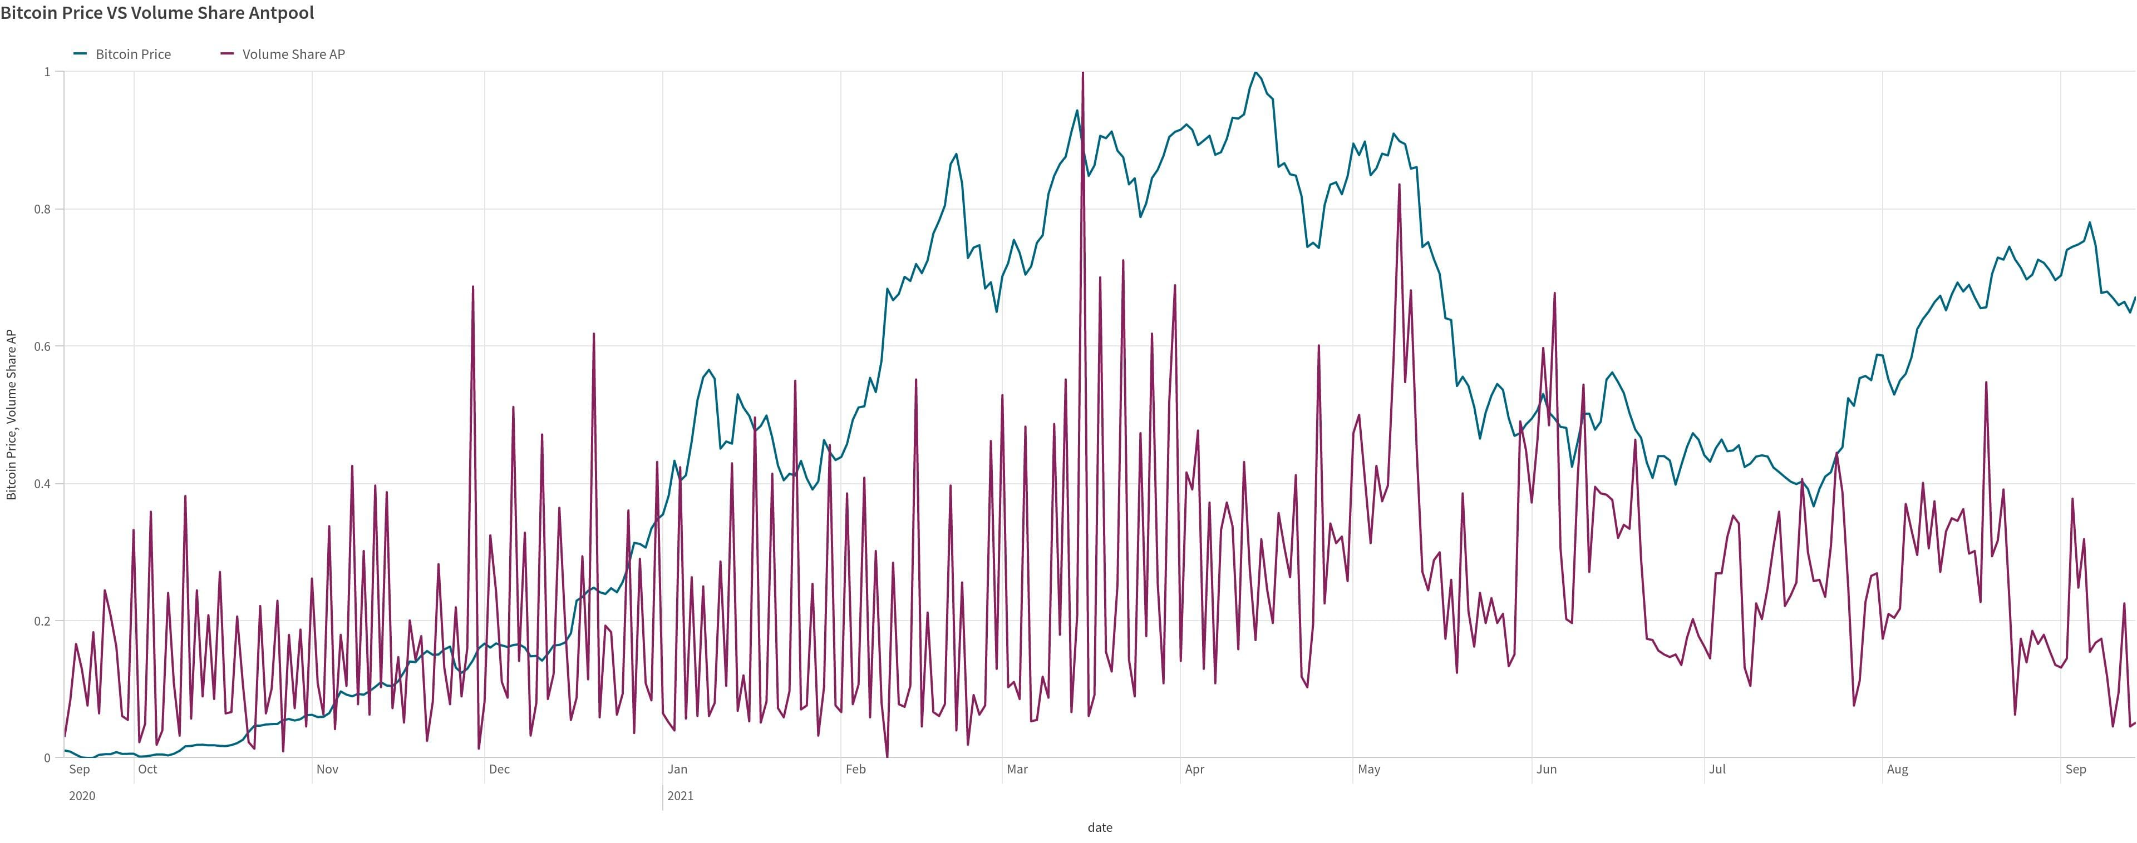
Features Engineering
High Volatility Features
Visualized High Volatility Features
Bitcoin Price VS Antpool Outflows
Bitcoin Price VS Volume Share Antpool
Good trend!
But too high Volatility!!!
Need Smoothing
DataEureka
Notes:
In the remaining features, some of them are perform well in our last feature selection steps. But when visualized, we can find them have a very high Volatility. for those features, smoothing is needed

Slide 16
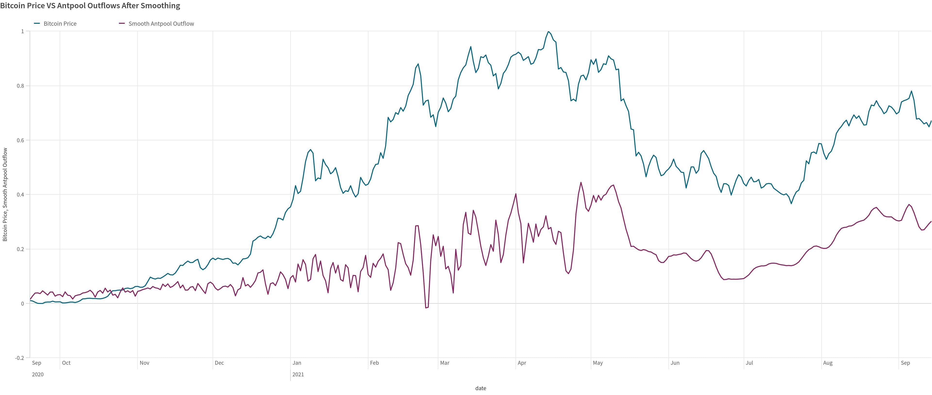
Features Engineering
After Smoothing…
Bitcoin Price VS Antpool Outflows After Smoothing
DataEureka
Notes:
after smooth, the feature line better fits the price lines, showing improvement in feature significancce.

Slide 17
Model Tuning
Tuning Model Architecture | Memory Cells
 | Hidden Layers
 | Weight Initialization
Tuning Learning Behavior | Learning Rate
 | Optimization Algorithm
 | Regularization
In Our Case：
1. Hidden size and epochs size are set low to prevent over-fitting
2. Used GridSearchCV to find the best number of layers, learning rate, and regularization.
Hidden Size:64,
Epochs Size:100
Learning Rate:0.01
weight decay for Adam: 0.01
Regularization:0.01
Notes:
We need to optimize the model with hyperparameter tuning for price prediction. which includes tuning model architecture and tuning learning behavior.
In this case, hidden size and epochs size are set not so high to prevent over-fitting according to our experience. Also, we used GridSearchCV to find the best number of layers, learning rate, and weight decay. All these parameters can effectively be used for bias-variance trade-off.
For our final best model, we set hidden size to be 64, epochs size to be 100, learning rate to be 0.01, and the weight decay for Adam to be 0.01. And apply these parameters to each round of LSTM we built.
With the best parameters and final data, the RMSE of our model reaches 0.02631. The scores of training data and test data are close to each other. So based on the preliminary study, our model is not over-fitted.

Slide 18
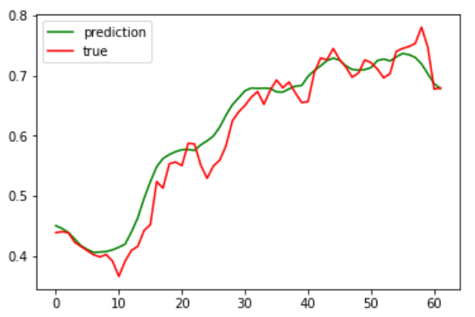
content requires update
Final Model Performance
1、Performance：
RMSE = 0.02631.
not over-fitted
2、Results：
last 10 days data
to predict
BTC price of the next day that is not in the data set
Price for 2021.9.15
Predicted: 48847.453
True price: 48150.90.
Predict & True
Notes:
With the best parameters and final data, the RMSE of our model reaches 0.02631. The scores of training data and test data are close to each other. So based on the preliminary study, our model is not over-fitted.
Finally, we used the last 20 data of our data set to predict the BTC price of the next day that is not in the data set. We predict the price for 2021.9.15 would be 48847.453, where the true price is 48150.90(收盘价)

Slide 19
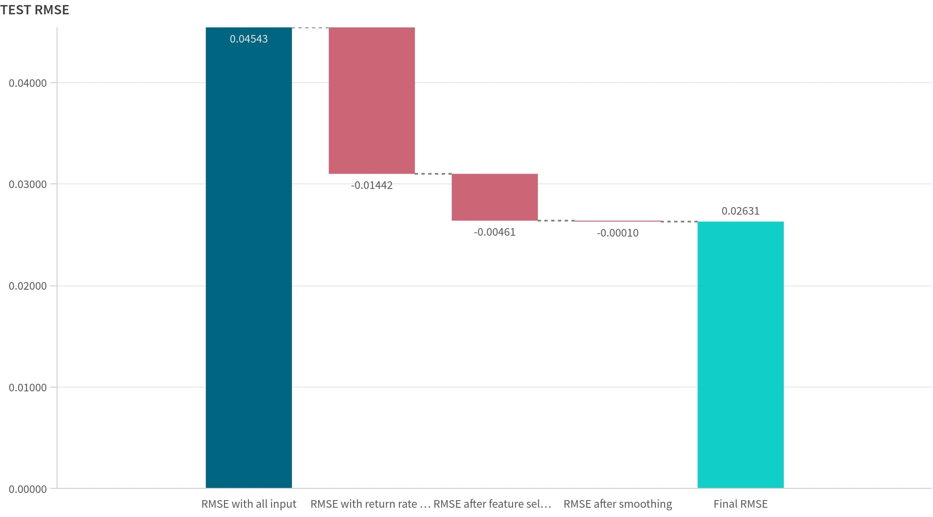
content requires update
Model Improvement
Test RMSE
RMSE Reduced by ~40%
1
2
3
Add return rate of Bitcoin as features
feature selection
After smoothing
DataEureka
Notes:
In our experiments from the baseline model, we have done:
1Add return rate of Bitcoin as features
2add some features and done feature selection
3 smoothing
and finally reached 40% drop of our rmse.
the model has improved a lot, and can predict bitcoin price with small discrepancies.

Slide 20
Model Limitation
1
2
3
average error is low
while the error of each day is sometimes significant
small dataset
no validation seperation
hence have risk for overfit
LSTM can only be used for predicting very near future
DataEureka
Notes:
Although the final RMSE is relatively small, there are still several limitations of our model:
Although the average error is low, the error of each day is sometimes significant
Due to the nature of time series model, LSTM can only be used for predicting very near future
The dataset is very small, so we didn’t split for another validation set, and we are using a powerful neural network model and repeat experiments on the same dataset many times. This all increase the risk of overfitting.

Slide 21
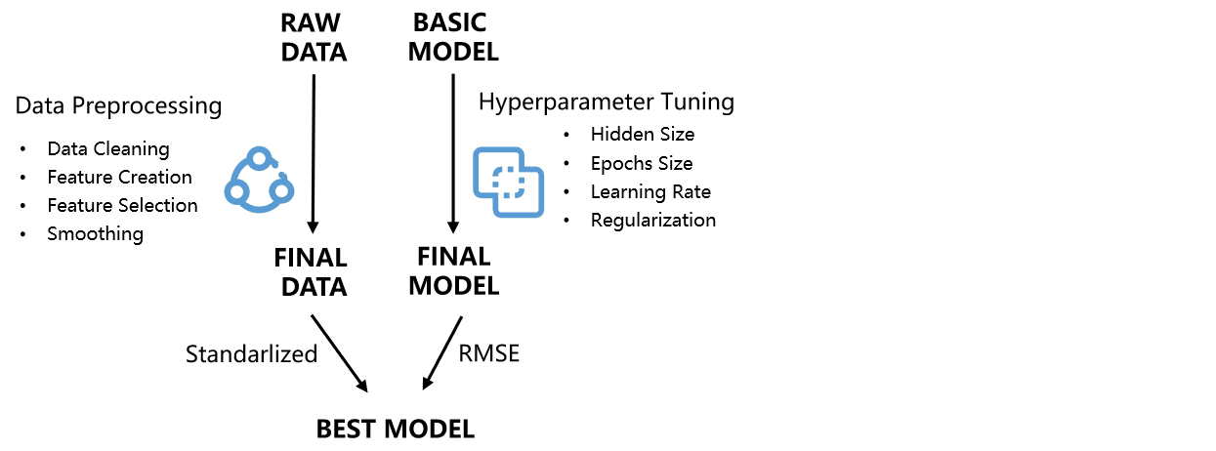
content requires update
Conclusion
Notes:
In our exercise, we process the data and tune the hyperparammeters, using rsme as performance indicator, trained to get our best model.
Despite our good prediction results, we still see limitation that we could improve in future experiments.
Thank you very much for listening! Hope you enjoy our video!

Slide 22
REFERENCE
LOGO
1. Chen, Zheshi et al. “Bitcoin price prediction using machine learning: An approach to sample dimension engineering.” J. Comput. Appl. Math. 365 (2020): n. pag.
2. Raju, Shobha Manival and Ali Mohammad Tarif. “Real-Time Prediction of BITCOIN Price using Machine Learning Techniques and Public Sentiment Analysis.” ArXiv abs/2006.14473 (2020): n. pag.
3. Bollen, Johan et al. “Twitter mood predicts the stock market.” ArXiv abs/1010.3003 (2011): n. pag.
4. Dutta, Aniruddha et al. “A Gated Recurrent Unit Approach to Bitcoin Price Prediction.” arXiv: Pricing of Securities (2019): n. pag.

Slide 23
Group member
LOGO
Ke Ma A0212524U
Xiao liang A0232007X
Mingzhe Xu A0232022A
Shaobin Qiao A0232196E
Yishun Liu A0231849X
Yunyi Gao A0231927A

Slide 24
LOGO
Thank you!

